Slide 1
INTRODUCTION TO Mathematical FOUNDATIONS FOR COMPUTER SCIENCE (2CS802CC25)
Prepared By:
Prof. Chandan Trivedi

Slide 2
Expectations FROM THE CLASS….
Attendance→ Less attendance will impact marks.
Punctuality in Class→ Late comers will be marked.
Interactive Sessions→ Learning together.
Participation in Class is Mandatory→ Weightage in Marks.
Enjoy the joy of learning→ Peer-Learning.
Feel free to interrupt and ask questions→ Doubt Clarity.
Be an observer→ Critical Thinking
And above all……. (a smiling face)

Slide 3

MFCS/discrete mathematics
Some Questions ---??
1. MATHS-NOT AGAIN…I have a fear of maths
2. HAVE WE NOT STUDIED ENOUGH MATHEMATICS ALREADY…HOW IS THIS DIFFERENT …??
3. WHAT TYPE OF MATHEMATICS WE HAVE STUDIED IN FIRST YEAR..
4. WHAT THIS “DISCRETE WORD” MEANS…
5. HOW IS IT RELATED EVEN TO COMPUTER SCIENCE…

Slide 4
OUTLINE OF THE LECTURE…
1. WHAT HAVE WE STUDIED IN MATHEMATICS TILL NOW
2. WHAT IS DISCRETE MATHEMATICS AND RELATIONS TO COMPUTER SCIENCES
3. THE BIG DIFFERENCE
4. WHAT IS COMPUTING
5. SOME REAL LIFE PROBLEMS
6. APPLICATION AREAS IN COMPUTER SCIENCE.

Slide 5
WHAT HAVE WE STUDIED IN MATHEMATICS TILL NOW
Most middle and high school math curricula follow a well-defined path:
Pre-algebra → Algebra 1 → Geometry → Algebra 2 → Trig / Precalculus → Calculus
SOME PROBLEMS
How many eight-digit numbers are there that contain a five and a six?
What's the smallest number of NAND gates you need to implement a logic circuit with the output response of a given truth table?
Draw a 5×5 grid graph. How many edges does the n×n grid graph have?

Slide 6
WHAT IS DISCRETE MATHEMATICS..??
THE QUESTIONS WERE HARD TO SOLVE BECAUSE WE ARE NOT FOCUSSING ON A FUNDAMENTAL FEATURE---
TREATING OBEJCTS AS INDEPENDENT ENTITIES..(AS INTEGERS)
Discrete mathematics is the study of mathematical structures that are fundamentally discrete rather than continuous…
Continuous Mathematics(WHAT WE HAVE LEARNT IN SCHOOLS)
It considers objects that vary continuously;
Example: analog wristwatch (separate hour, minute, and second hands).
Real-number system --- core of continuous mathematics.
Models and tools for analyzing real-world phenomena that change smoothly
over time. (Differential equations etc.)

Slide 7
The big difference
COMPUTERS ARE DIGITAL→ UNDERSTAND STRINGS OF 0’S AND 1’S→NUMBERS AS FINITE BIT STRINGS→ TO SOLVE REAL LIFE PROBLEMS OF COMPUTER SCIENCE→ DISCRETE MATHEMATICS→ MODELS AND TOOLS FOR ANALYZING REAL-WORLD PHENOMENA THAT CHANGE DISCRETELY OVER TIME.
Ex: digital wristwatch
Discrete math is essential to college-level mathematics and beyond.
Discrete math is the mathematics of computing.
Discrete math is very much "real world" mathematics.
Discrete math teaches mathematical reasoning and proof techniques.

Slide 8
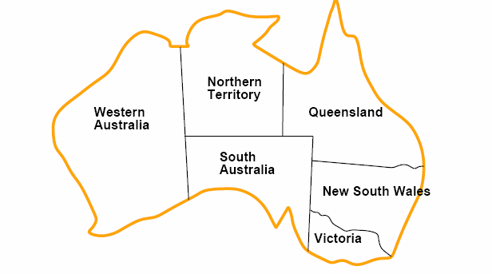
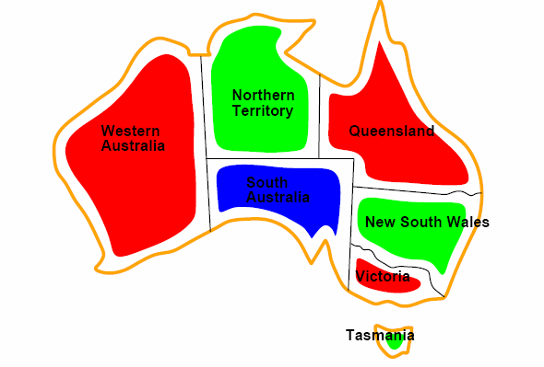
WHAT IS COMPUTING??
WHAT is the value of 16*16=256(easy for humans)
WHAT is the value of 1255678888⁴⁵⁶ –very difficult for humans—but easy for computers.
Is solving hard arithmetic problems called computing→ANSWER IS NO.
WHAT IS A COMPUTATIONAL PROBLEM?
How to color this map so that no two adjacent regions have the same color?

Slide 9
MAPPING OF THE previous PROBLEM to other problems
How can the final exams at Nirma University be scheduled so that no student has two exams at the same time?
T.V. channels 2 through 13 are assigned to stations in Ahmedabad so that no two stations within 150 kms. can operate on the same channel. How can the assignment of channels be modeled as a graph coloring?
In efficient compilers the execution of loops can be speeded up by storing frequently used variables temporarily in registers in the central processing unit, instead of the regular memory. For a given loop, how many index registers are needed?

Slide 10
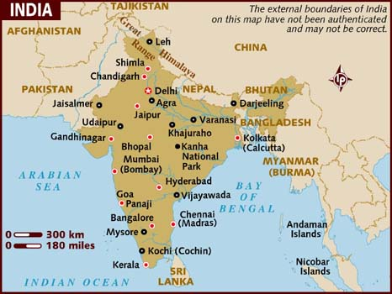
SOME REAL LIFE PROBLEMS
THE TRAVELLING SALESMAN PROBLEM:
Given a list of cities and the distances between each pair of cities, what is the shortest possible route that visits each city and returns to the origin city?
MODEL THE PROBLEM AS A GRAPH- A DISCRETE MATHEMATICAL STRUCTURE

Slide 11
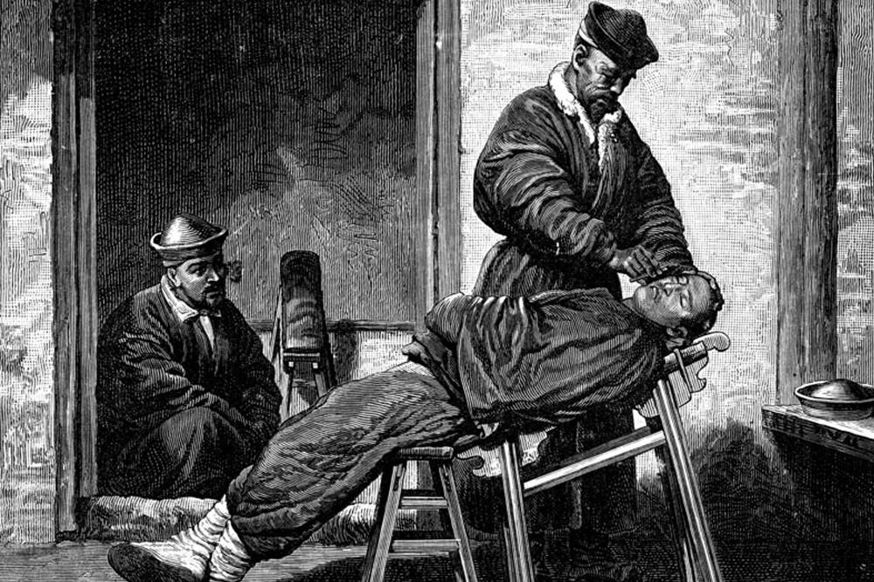
THE ANCIENT BARBER PROBLEM
An ancient Sicilian legend says that the barber in a remote town who can be reached only by traveling a dangerous mountain road shaves those people, and only those people, who do not shave themselves. Can there be such a barber?
MODEL THE PROBLEM AS LOGIC- A DISCRETE MATHEMATICAL STRUCTURE

Slide 12
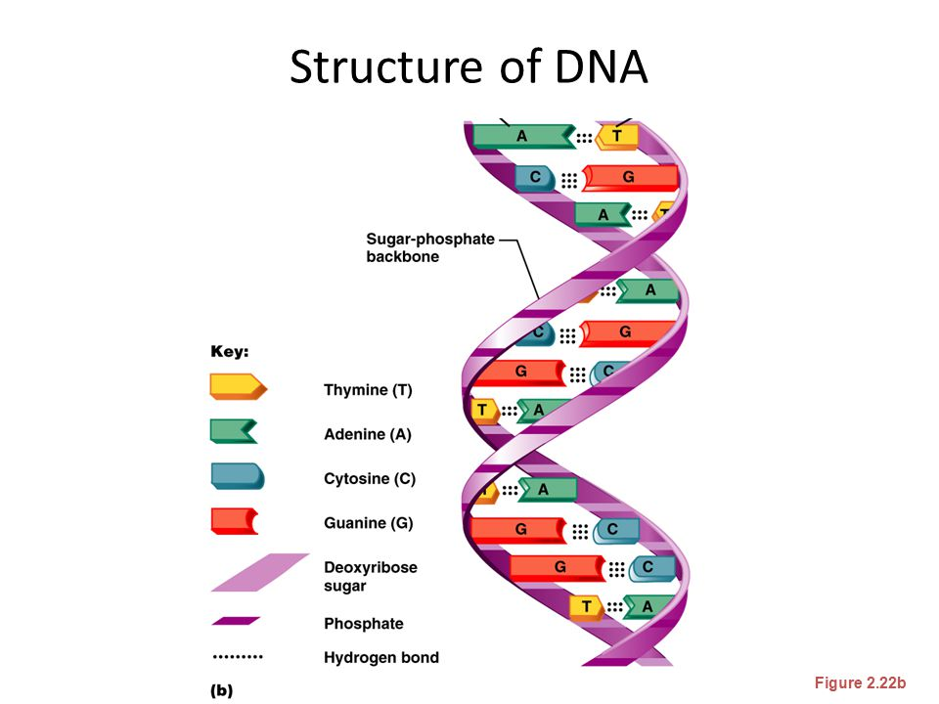
THE DNA PROBLEM
THERE ARE TWO SPECIES …what is the longest strand of DNA matching….the more the MATCH…the more they are similar.
MODEL THE PROBLEM AS AN RECURSIVE FORMULA….THEN BUILD THE ALGORITHM…REQUIRES KNOWLEDGE OF RECURSION

Slide 13
APPLICATION AREAS OF DISCRETE MATHEMATICS
Web searches-efficient use of keywords
Google Maps-shortest path or route
Artificial Intelligence- designing of intelligent neural networks
Network Security- designing of cryptographically secure systems.
Computer Graphics and animation- working on pixels as an object.
Mobile Communications- frequency allocation problem
Data Compression- algorithms for compressing a file
Database Management Systems- using relations
Social Network Analysis- predicting sentiment analysis, viral spread of information
Designing of Radars and Satellite Communication system
Performance and measuring correctness of an algorithm…..and many more….
SO WHAT HAVE WE LEARNT→ DISCRETE MATHEMATICS GIVES US THE MATEMATICAL MODELLING AND UNDERSTANDING TO MAP A REAL LIFE PROBLEM TO A DISCRETE STRUCTURE→HENCE RIGHTLY IT IS CALLED THE FOUNDATION MATHEMATICAL PRINCIPLES THAT BUILD UP COMPUTER SCIENCE

Slide 14
UNIT-1 Sets, Relation and Function

Slide 15
SYLLABUS OF UNIT-1
Operations and laws of sets
Cartesian products
Binary relation
Partial ordering relation
Equivalence relation,
Image of a set
Sum and product of functions,
Bijective functions
Inverse and composite function.
Basic counting techniques: inclusion and exclusion, pigeon-hole principle.

Slide 16
Set Theory
Definition of sets
Describing Sets
Roster Method
Set-Builder Notation
Some Important Sets in Mathematics
Empty Set and Universal Set
Subsets and Set Equality
Cardinality of Sets
Tuples
Cartesian Product

Slide 17
Introduction
Sets are one of the basic building blocks for the types of objects considered in discrete mathematics.
Important for counting.
Programming languages have set operations.
Set theory is an important branch of mathematics.
Many different systems of axioms have been used to develop set theory.
Here we are not concerned with a formal set of axioms for set theory. Instead, we will use what is called naïve set theory.

Slide 18
Sets-Membership
A set is an unordered collection of objects.
the students in this class
the chairs in this room
The objects in a set are called the elements, or members of the set. A set is said to contain its elements.
The notation a ∈ A denotes that a is an element of the set A.
If a is not a member of A, write a ∉ A

Slide 19
Describing a Set
S = {a,b,c,d}
Order not important
S = {a,b,c,d} = {b,c,a,d}
Each distinct object is either a member or not; listing more than once does not change the set.
S = {a,b,c,d} = {a,b,c,b,c,d}
Elipses (…) may be used to describe a set without listing all of the members when the pattern is clear.
S = {a,b,c,d, ……,z }

Slide 20
Set Representation:Roster Method
Set of all vowels in the English alphabet:
V = {a,e,i,o,u}
Set of all odd positive integers less than 10:
O = {1,3,5,7,9}
Set of all positive integers less than 100:
S = {1,2,3,……..,99}
Set of all integers less than 0:
S = {…., -3,-2,-1}

Slide 21
Some Important Sets
N = natural numbers = {0,1,2,3….}
Z = integers = {…,-3,-2,-1,0,1,2,3,…}
Z⁺ = positive integers = {1,2,3,…..}
R = set of real numbers
R⁺ = set of positive real numbers
C = set of complex numbers.
Q = set of rational numbers

Slide 22
Set Representation:Set-Builder Notation
Specify the property or properties that all members must satisfy:
S = {x | x is a positive integer less than 100}
O = {x | x is an odd positive integer less than 10}
O = {x ∈ Z⁺ | x is odd and x < 10}
A predicate may be used:
S = {x | P(x)}
Example: S = {x | Prime(x)}
Positive rational numbers:
Q⁺ = {x ∈ R | x = p/q, for some positive integers p,q}

Slide 23
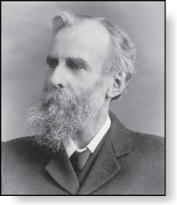
Universal Set and Empty Set
The universal set U is the set containing everything currently under consideration.
Sometimes implicit
Sometimes explicitly stated.
Contents depend on the context.
The empty set is the set with no
elements. Symbolized ∅, but
{} also used.
Venn Diagram
U
V
a e i
o u
John Venn (1834-1923)
Cambridge, UK

Slide 24
Some things to remember
Sets can be elements of sets.
A= {{1,2,3},a, {b,c}}
B= {N,Z,Q,R}
The empty set is different from a set containing the empty set.
∅ ≠ { ∅ } ({∅} is the set containing the empty element, singleton set)

Slide 25
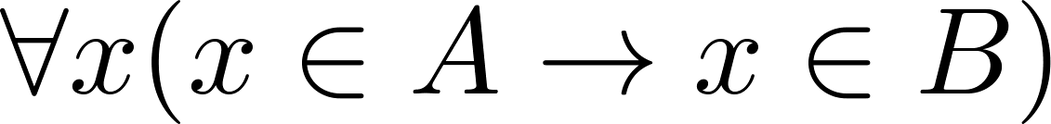
Subsets
Definition: The set A is a subset of B, if and only if every element of A is also an element of B.
The notation A ⊆ B is used to indicate that A is a subset of the set B.
A ⊆ B holds if and only if is true.

Slide 26
Showing a Set is or is not a Subset of Another Set
Showing that A is a Subset of B: To show that A ⊆ B, show that if x belongs to A, then x also belongs to B.
Showing that A is not a Subset of B: To show that A is not a subset of B, A ⊈ B, find an element x ∈ A with x ∉ B. (Such an x is a counterexample to the claim that x ∈ A implies x ∈ B.)
Examples:
The set of all computer science majors at your school is a subset of all students at your school.
The set of integers with squares less than 100 is not a subset of the set of nonnegative integers.

Slide 27
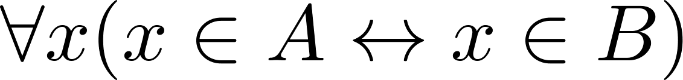
Set Equality
Definition: Two sets are equal if and only if they have the same elements. A ⊆B and B ⊆A.
Therefore if A and B are sets, then A and B are equal if and only if .
We write A = B if A and B are equal sets.
{1,3,5} = {3, 5, 1}
{1,5,5,5,3,3,1} = {1,3,5}

Slide 28
Another look at Equality of Sets
Recall that two sets A and B are equal, denoted by A = B, iff
Using logical equivalences we have that A = B iff
This is equivalent to
A ⊆ B and B ⊆ A

Slide 29
Proper Subsets
Definition: If A ⊆ B, but A ≠B, then we say A is a proper subset of B, denoted by A ⊂ B. If A ⊂ B, then
is true.
Venn Diagram
U
B
A

Slide 30
Set Cardinality
Definition: If there are exactly n distinct elements in S where n is a nonnegative integer, we say that S is finite. Otherwise it is infinite.
Definition: The cardinality of a finite set A, denoted by |A|, is the number of (distinct) elements of A.
Examples:
|ø| = 0
Let S be the letters of the English alphabet. Then |S| = 26
|{1,2,3}| = 3
|{ø}| = 1
The set of integers is infinite.

Slide 31
Power Sets
Definition: The set of all subsets of a set A, denoted P(A), is called the power set of A.
Example: If A = {a,b} then
P(A) = {ø, {a},{b},{a,b}}
P(ø)={ø}
P({ø})={ø,{ø}}
P({ø,{ø}})={ø,{ø},{{ø}},{ø,{ø}}} and so on…
If a set has n elements, then the cardinality of the power set is 2ⁿ. How to prove

Slide 32
Set Operations

Slide 33
Section Summary
Set Operations
Union
Intersection
Complementation
Difference
More on Set Cardinality
Set Identities
Proving Identities
Membership Tables

Slide 34
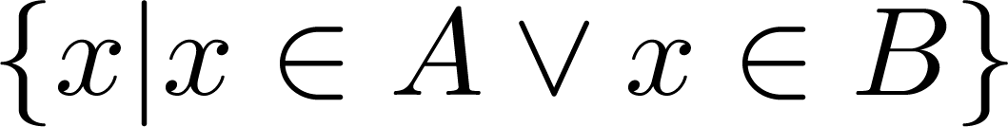
Union
Definition: Let A and B be sets. The union of the sets A and B, denoted by A ∪ B, is the set:
Example: What is {1,2,3} ∪ {3, 4, 5}?
Solution: {1,2,3,4,5}
Venn Diagram for A ∪ B
U
A
B

Slide 35
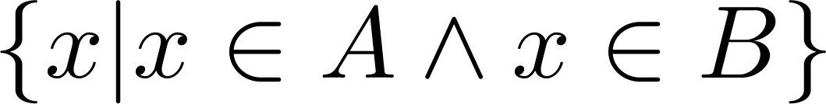
Intersection
Definition: The intersection of sets A and B, denoted by A ∩ B, is
Note if the intersection is empty, then A and B are said to be disjoint.
Example: What is? {1,2,3} ∩ {3,4,5} ?
Solution: {3}
Example: What is?
{1,2,3} ∩ {4,5,6} ?
Solution: ∅
Venn Diagram for A ∩B
U
A
B

Slide 36
Complement
Definition: If A is a set, then the complement of the A (with respect to U), denoted by Ā is the set U - A
Ā = {x ∈ U | x ∉ A}
(The complement of A is sometimes denoted by A^{c} .)
Example: If U is the positive integers less than 100, what is the complement of {x | x > 70}
Solution: {x | x ≤ 70}
Venn Diagram for Complement
U
Ā
A

Slide 37
Difference
Definition: Let A and B be sets. The difference of A and B, denoted by A – B, is the set containing the elements of A that are not in B. The difference of A and B is also called the complement of B with respect to A.
A – B = {x | x ∈ A ∧ x ∉ B} = A ∩‾B
U
Venn Diagram for A − B
A
B

Slide 38


Symmetric Difference (optional)
Definition: The symmetric difference of A and B, denoted by is the set
Example:
U = {0,1,2,3,4,5,6,7,8,9,10}
A = {1,2,3,4,5} B ={4,5,6,7,8}
What is :
Solution: {1,2,3,6,7,8}
U
A
B
Venn Diagram

Slide 39
Review Questions
Example: U = {0,1,2,3,4,5,6,7,8,9,10} A = {1,2,3,4,5}, B ={4,5,6,7,8}
A ∪ B
Solution: {1,2,3,4,5,6,7,8}
A ∩ B
Solution: {4,5}
Ā
Solution: {0,6,7,8,9,10}
Solution: {0,1,2,3,9,10}
A – B
Solution: {1,2,3}
B – A
Solution: {6,7,8}

Slide 40



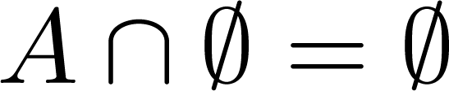


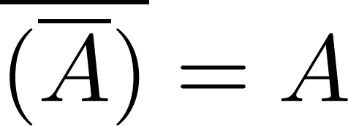
Set Identities
Identity laws
Domination laws
Idempotent laws
Complementation law
Continued on next slide →

Slide 41


Set Identities
Commutative laws
Associative laws
Distributive laws
Continued on next slide →

Slide 42





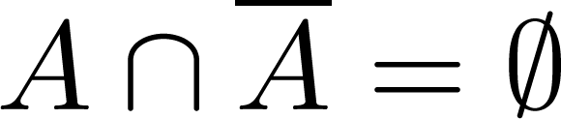
Set Identities
De Morgan’s laws
Absorption laws
Complement laws

Slide 43
Proving Set Identities
Different ways to prove set identities:
Prove that each set (side of the identity) is a subset of the other.
Use set builder notation and propositional logic.
Membership Tables: Verify that elements in the same combination of sets always either belong or do not belong to the same side of the identity. Use 1 to indicate it is in the set and a 0 to indicate that it is not.

Slide 44


Proof of Second De Morgan Law
Example: Prove that
Solution: We prove this identity by showing that:
1)
and
2)
Continued on next slide →

Slide 45
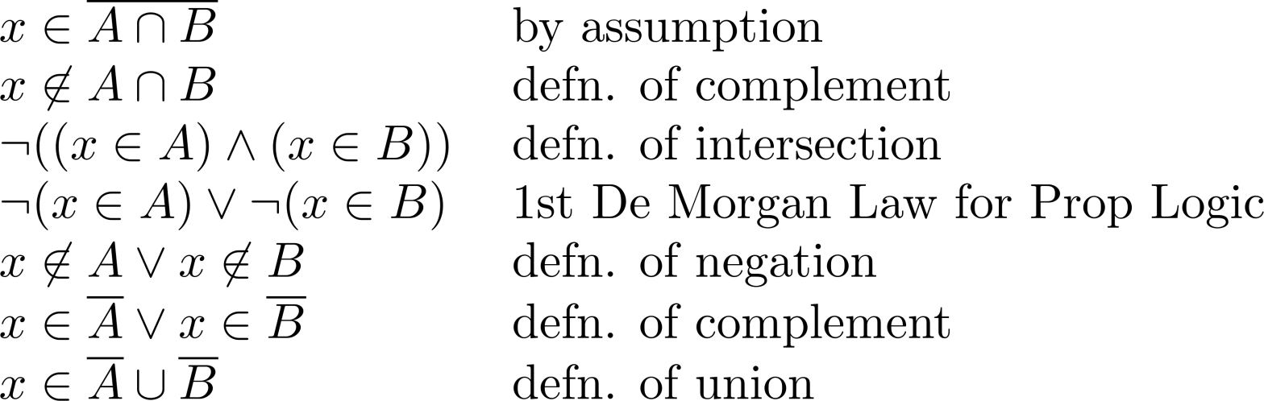
Proof of Second De Morgan Law
These steps show that:
Continued on next slide →

Slide 46
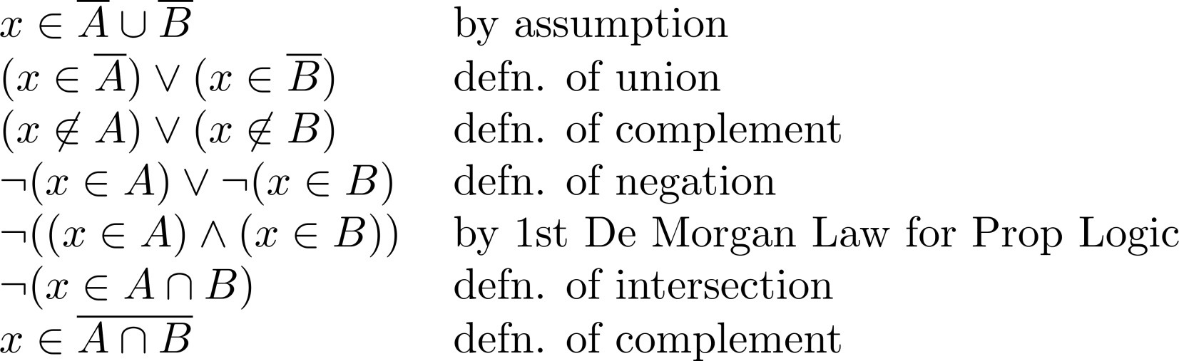
Proof of Second De Morgan Law
These steps show that:

Slide 47
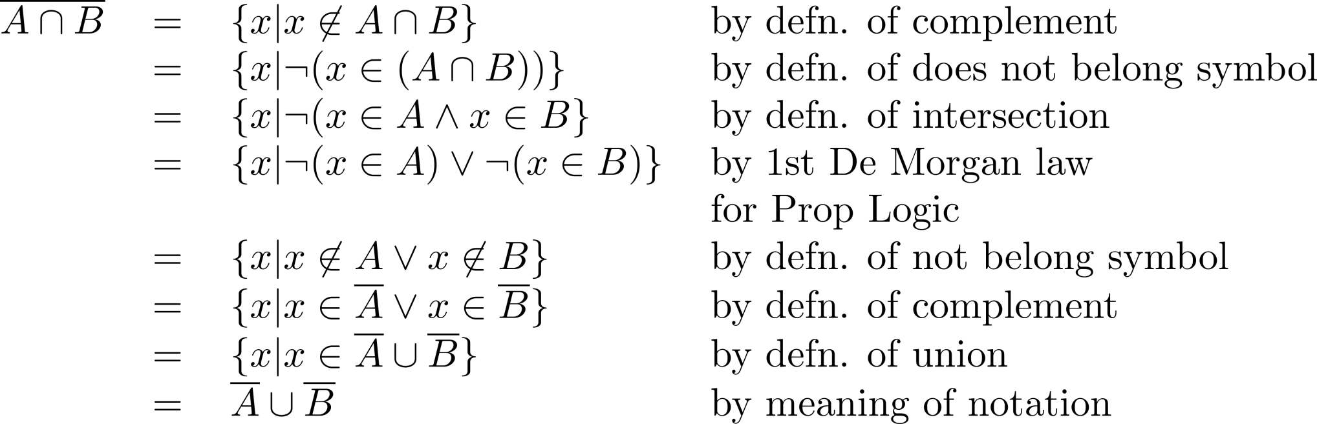
Set-Builder Notation: Second De Morgan Law

Slide 48





Membership Table
Example:
Construct a membership table to show that the distributive law holds.
Solution:
A | B | C
1 | 1 | 1 | 1 | 1 | 1 | 1 | 1
1 | 1 | 0 | 0 | 1 | 1 | 1 | 1
1 | 0 | 1 | 0 | 1 | 1 | 1 | 1
1 | 0 | 0 | 0 | 1 | 1 | 1 | 1
0 | 1 | 1 | 1 | 1 | 1 | 1 | 1
0 | 1 | 0 | 0 | 0 | 1 | 0 | 0
0 | 0 | 1 | 0 | 0 | 0 | 1 | 0
0 | 0 | 0 | 0 | 0 | 0 | 0 | 0

Slide 49
Inclusion-Exclusion Principle

Slide 50
Sum Rule
If sets A and B are disjoint, then
|A ∪ B| = |A| + |B|
A
B
What if A and B are not disjoint?

Slide 51
Inclusion-Exclusion (2 sets)
For two arbitrary sets A and B
A
B

Slide 52
Inclusion-Exclusion (2 sets)
Let S be the set of integers from 1 through 1000 that are multiples of 3 or multiples of 5.
Let A be the set of integers from 1 to 1000 that are multiples of 3.
Let B be the set of integers from 1 to 1000 that are multiples of 5.
It is clear that S is the union of A and B,
but notice that A and B are not disjoint.
A
B
|A| = 1000/3 = 333
|B| = 1000/5 = 200
A ∩ B is the set of integers that are multiples of 15, and so |A ∩ B| = 1000/15 = 66
So, by the inclusion-exclusion principle, we have |S| = |A| + |B| - |A ∩ B| = 467.

Slide 53
Inclusion-Exclusion (3 sets)
|A ∪ B ∪ C| = |A| + |B| + |C|
– |A ∩ B| – |A ∩ C| – |B ∩ C|
+ |A ∩ B ∩ C|
A
B
C

Slide 54
Inclusion-Exclusion (3 sets)
From a total of 50 students:
|A|
30 know Java
18 know C++
26 know C#
9 know both Java and C++
16 know both Java and C#
8 know both C++ and C#
47 know at least one language.
|B|
|C|
How many know none?
How many know all?
|A ∩ B|
|A ∩ C|
|B ∩ C|
|A ∩ B ∩ C|
|A ∪ B ∪ C|
|A ∪ B ∪ C| = |A| + |B| + |C| – |A ∩ B| – |A ∩ C| – |B ∩ C| + |A ∩ B ∩ C|
47 = 30 + 18 + 26 – 9 – 16 – 8 + |A ∩ B ∩ C|
|A ∩ B ∩ C| = 6

Slide 55
Inclusion-Exclusion (4 sets)
|A ∪ B ∪ C ∪ D| = |A| + |B| + |C| + |D|
– |A ∩ B| – |A ∩ C| – |A ∩ D| – |B ∩ C| – |B ∩ D| – |C ∩ D|
+ |A ∩ B ∩ C| + |A ∩ B ∩ D| + |A ∩ C ∩ D| + |B ∩ C ∩ D|
– |A ∩ B ∩ C ∩ D |
A
B
C
D

Slide 56
Inclusion-Exclusion (n sets)
What is the inclusion-exclusion formula for the union of n sets?

Slide 57
Inclusion-Exclusion (n sets)
sum of sizes of all single sets
– sum of sizes of all 2-set intersections
+ sum of sizes of all 3-set intersections
– sum of sizes of all 4-set intersections
…
+ (–1)^{n+1} × sum of sizes of intersections of all n sets

